Slide 1

Production RAG
[Your Full Name Here]
AI SYSTEMS ENGINEER

Slide 2
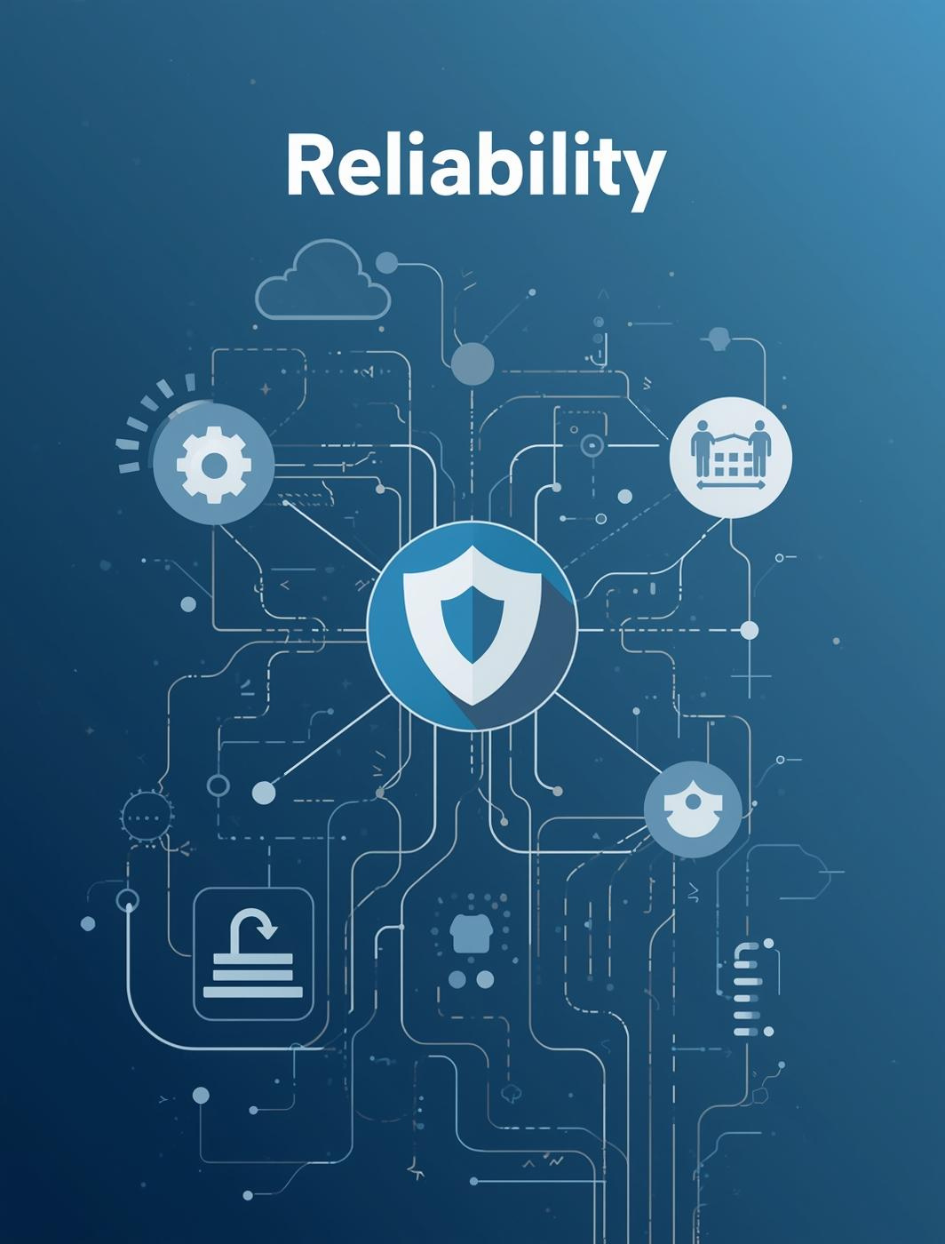
Why RAG Matters
Understanding the critical need for RAG systems in production environments
RAG systems are essential for mitigating the hallucination risk associated with standalone LLMs. They provide enhanced control over private data and ensure traceability, making them indispensable for organizations that prioritize data accuracy and reliability in their AI applications.

Slide 3
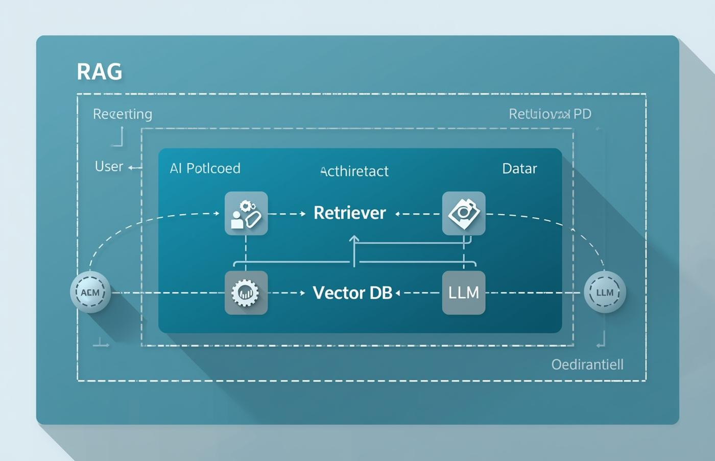
High-Level RAG System Architecture
System Flow
This architecture illustrates how components interact seamlessly.

Slide 4


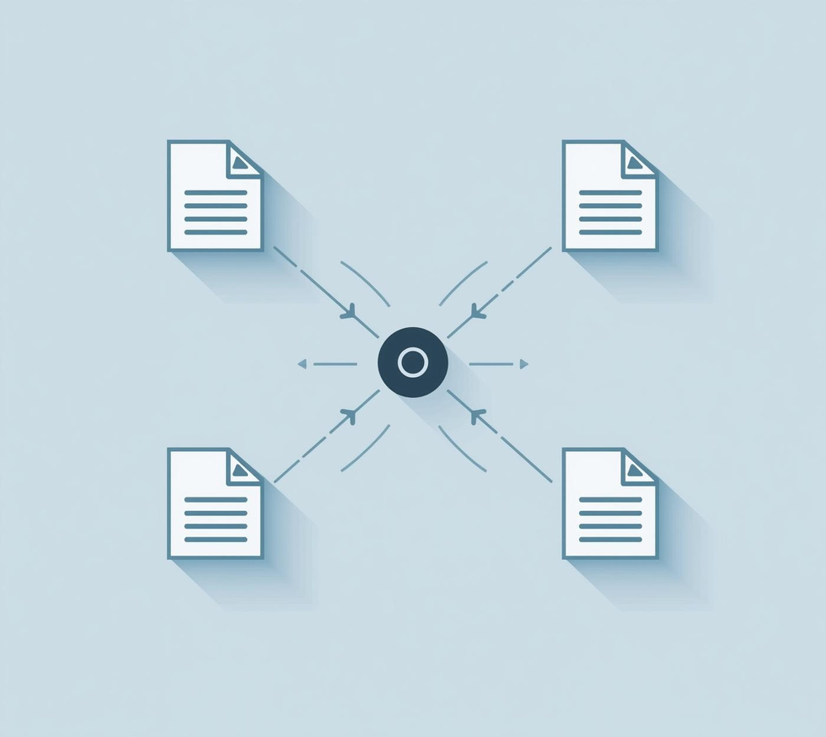
LangFlow Pipeline
File Loader
Text Splitter
Embedding Node
Import various data formats seamlessly.
Divide content into manageable chunks.
Transform text into vector representations.

Slide 5
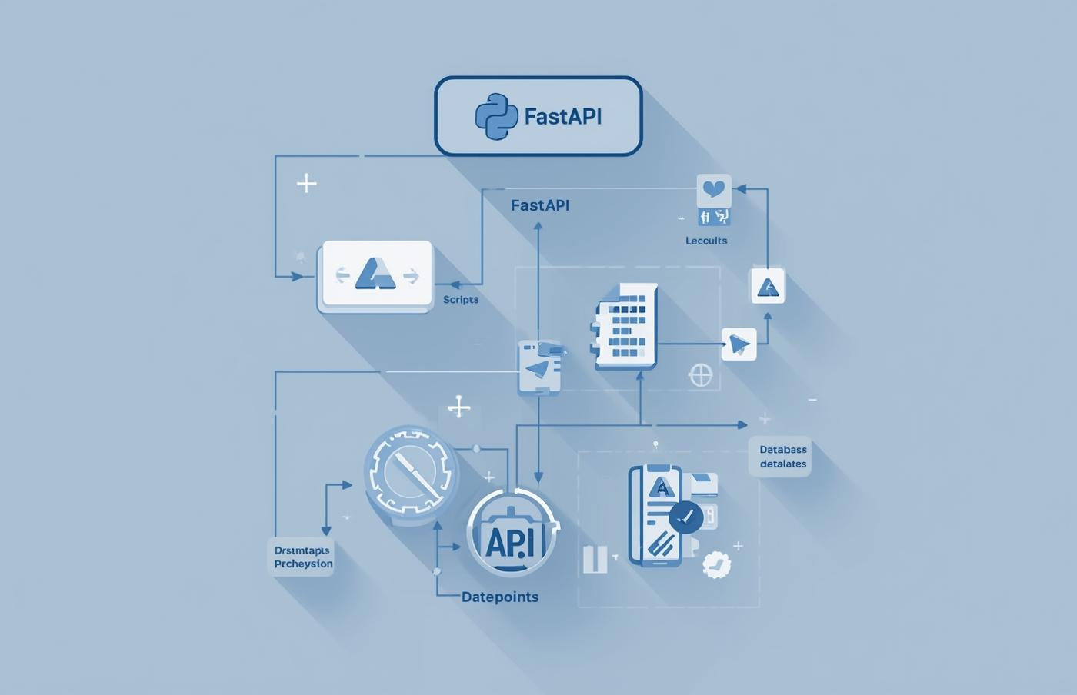
Python Backend Implementation Details
Backend Framework
FastAPI enables quick and efficient API development.

Slide 6
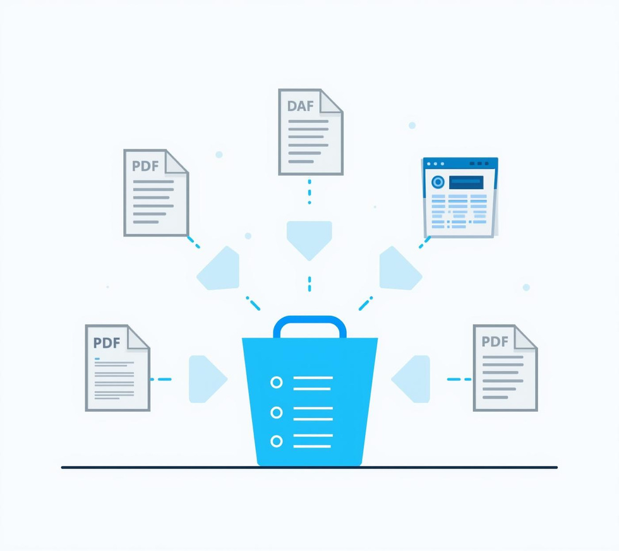
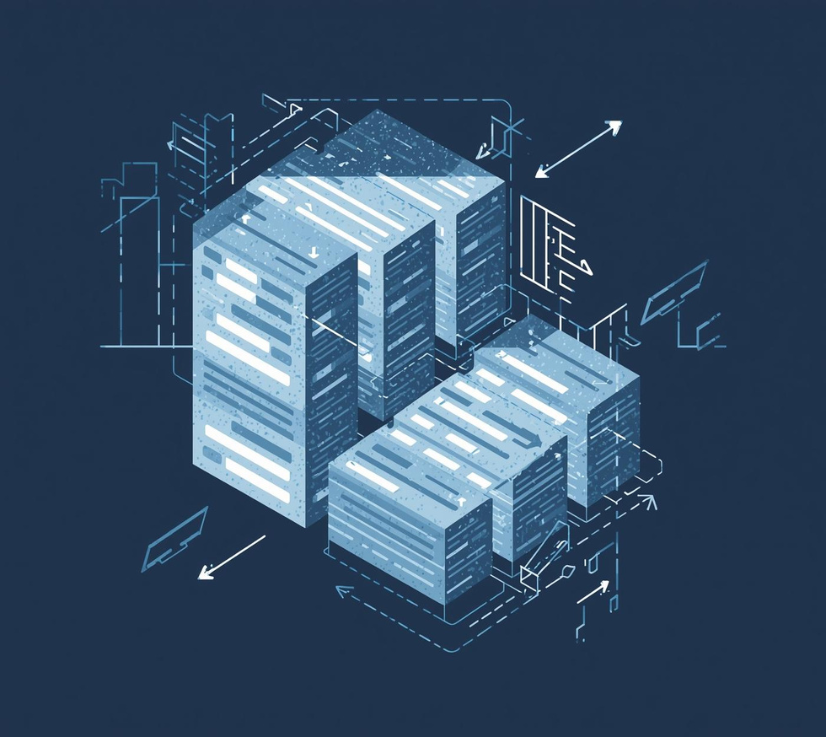
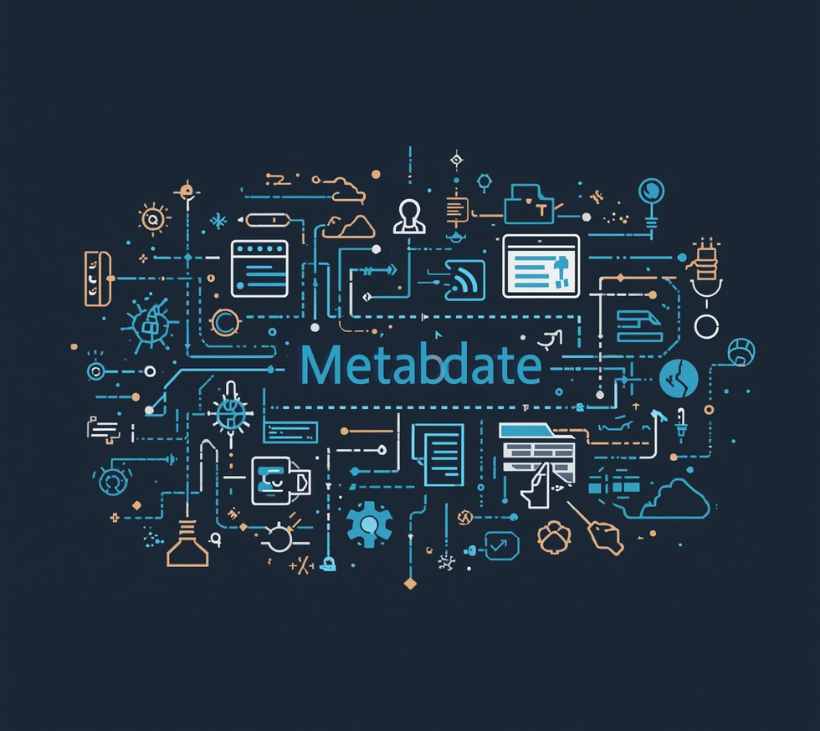
Data Preparation
Loaders
Chunking
Metadata
Effective tools for loading various data formats.
Breaking data into manageable pieces for processing.
Organizing data attributes for enhanced searchability.

Slide 7

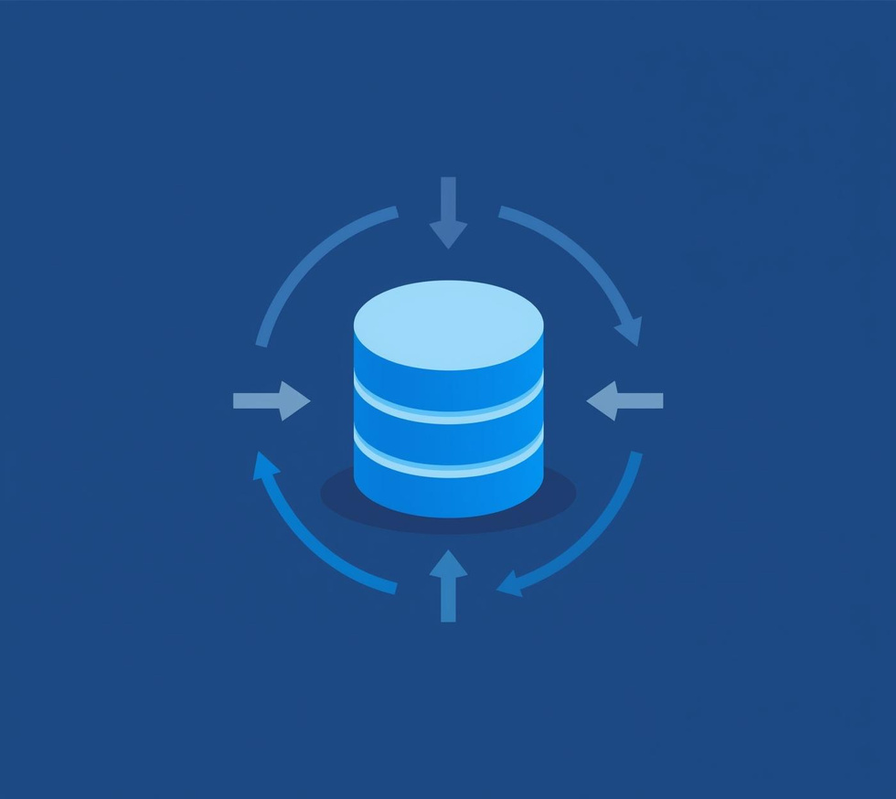

Embeddings & Databases
Semantic Search
Vector Storage
Data Processing
Facilitates efficient information retrieval and discovery.
Stores embeddings for rapid access and filtering.
Transforms raw data into semantic representations.

Slide 8
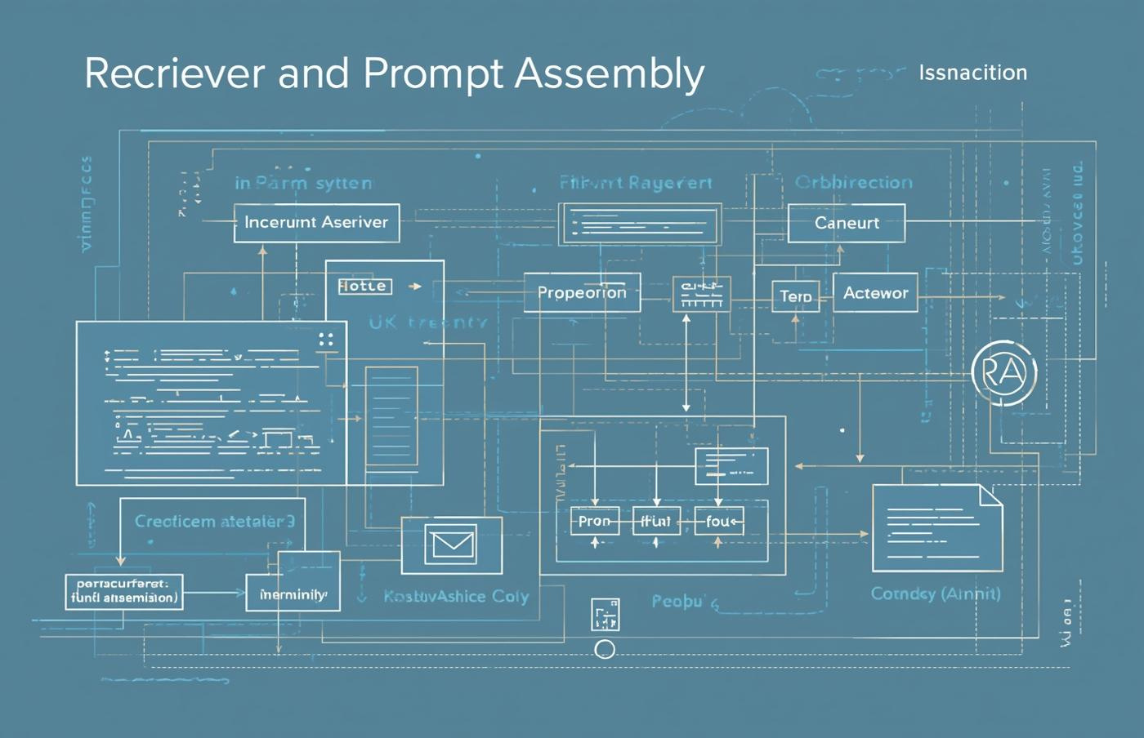
Retriever and Prompt Assembly
Context Building
Efficiently integrates retrieval results into coherent prompts.

Slide 9
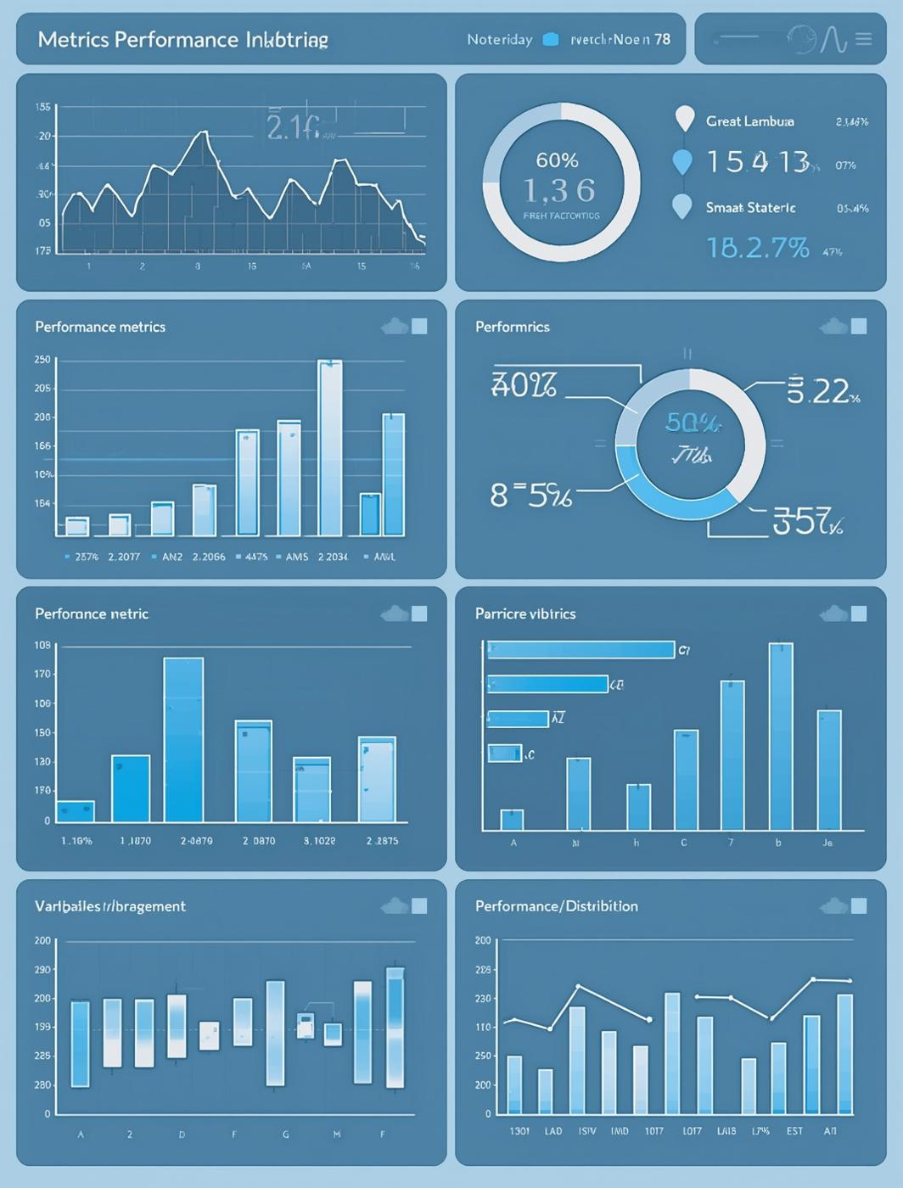
85%
This statistic highlights the accuracy of generated responses, showcasing the system's ability to produce relevant and reliable answers while optimizing performance and user satisfaction.

Slide 10
Contact
WEBSITE
reallygreatsite.com
Get in Touch for Collaboration Opportunities
EMAIL
hello@reallygreatsite.com
PHONE
123-456-7890

